Slide 1

Examples
Master Method
Design and Analysis of Algorithms I

Slide 2
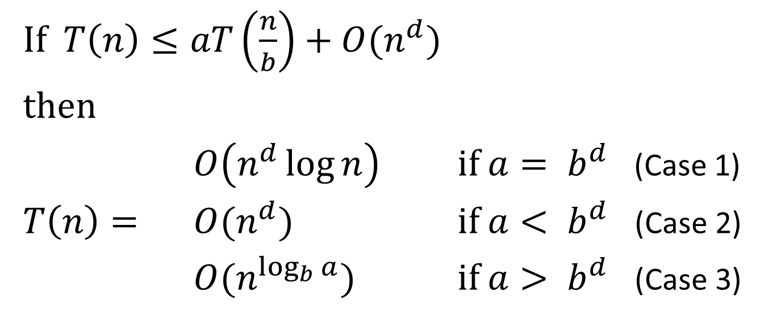
The Master Method
If $T\left(n\right)≤aT\left(\frac{n}{b}\right)+O(n^{d})$
then
$O\left(n^{d}\log{n}\right)$ if $a= b^{d}$ (Case 1)
$T\left(n\right)=$ $O(n^{d})$ if $a< b^{d}$ (Case 2)
$O(n^{\log_{b}{a}})$ if $a> b^{d}$ (Case 3)

Slide 3
Example #1

Slide 4

Where are the respective values of $a, b, d$ for a binary search of a sorted array, and which case of the Master Method does this correspond to?
1, 2, 0 [Case 1]
$1, 2, 1$ [Case 2]
$2, 2, 0$ [Case 3]
$$2, 2, 1 \text{[}\text{Case}\text{ 1]}$$

Slide 5
Example #3

Slide 6

Where are the respective values of $a, b, d$ for Gauss’s recursive integer multiplication algorithm, and which case of the Master Method does this correspond to?
$$2, 2, 1 \text{[}\text{Case}\text{ 1]}$$
$$3, 2, 1 \text{[}\text{Case}\text{ 1]}$$
$$3, 2, 1 \text{[}\text{Case}\text{ 2]}$$
$$3, 2, 1 \text{[}\text{Case}\text{ 3]}$$

Slide 7
Example #5

Slide 8
Example #6

